Slide 1

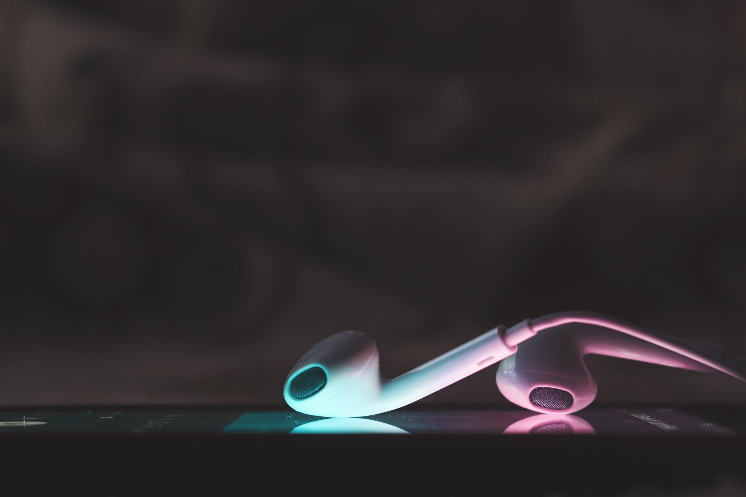
An app that keeps the music listening experience simple, so you can have experience the music you love
var defaultNumberOne;
Jessica La Torre Jeff Swafford Frey Lingle John Basilli
Notes:
Jessica’s slide

Slide 2
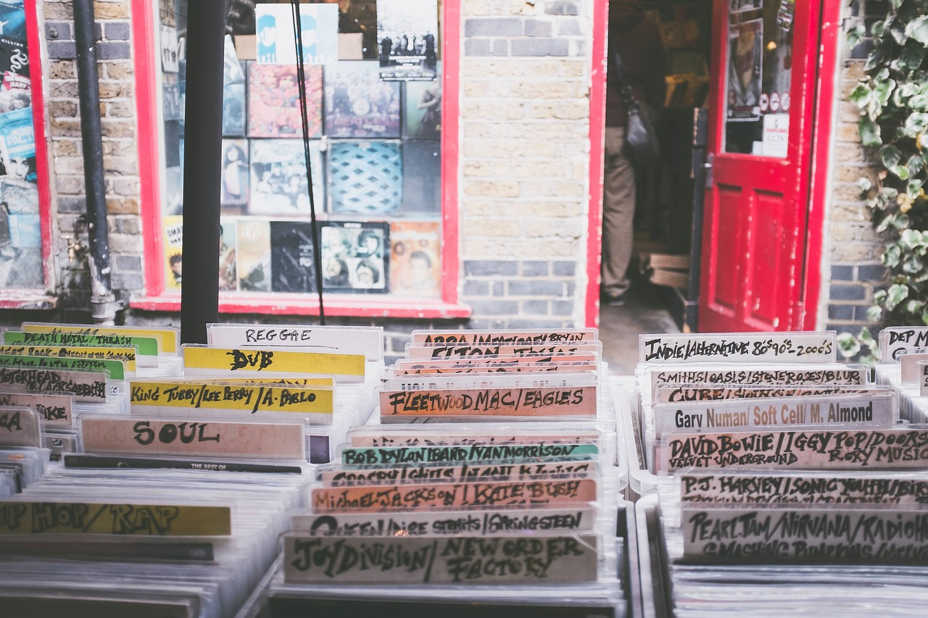

opportunity
Finding new music can be time-consuming when you have to sift through music recommendations spit out by algorithms. We decided to cut the fat.
We coded an app to help music lovers get to their core preferences quickly and to have a more holistic view of the artist through their image and sound.
Notes:
Jessica’s slide

Slide 3
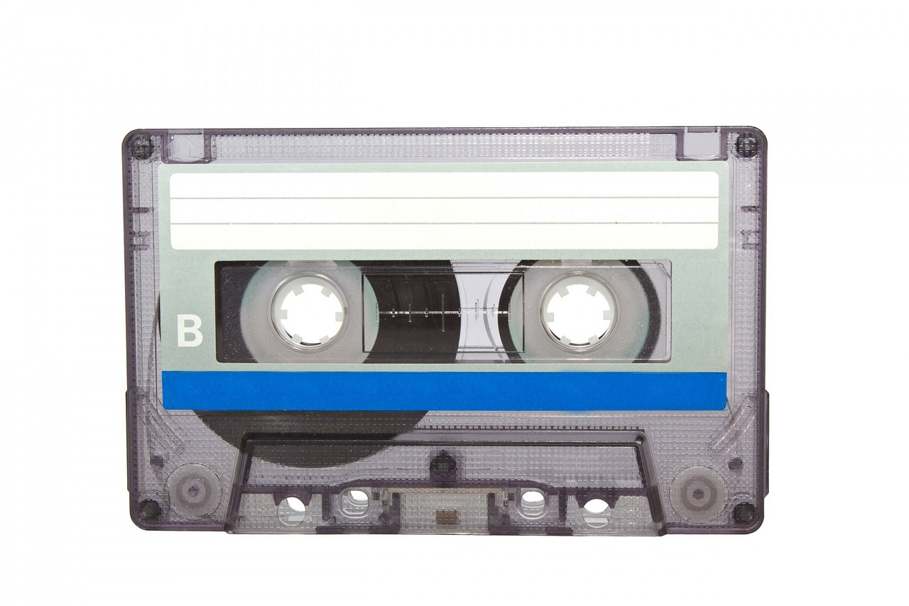
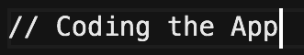

Selected the best APIs for to create simple mixes
YouTube selected for artist videos
Last.fm allows the user to view an artist bio and photo
Libraries
Prototype - Create class objects or mimic response objects
JQuery - Enables quick manipulation of event handling
Bootstrap - Allows for a easily formatted responsive design
Notes:
Jeff’s Slide

Slide 4

Creating a Vibe
Personal
Eye-catching design pays homage to retro music but embraces the moment
Tailored
Five suggestions display in collapsable vintage folders
Simple
Less time sifting through suggestions and more time tuning in
Notes:
Frey’s slide

Slide 5
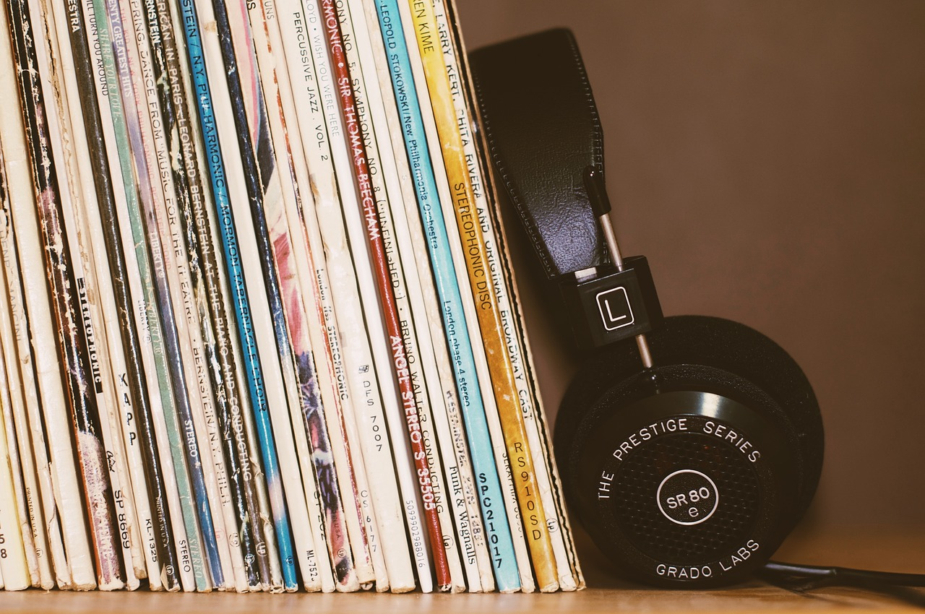
Let’s starting searching for artists!
Notes:
John’s slide

Slide 6



To do List
Customize new playlists by choosing artists from search results
Store user preferences in Firebase to main continuity across browsers & devices
Build an algorithm based on search history to recommend related artists
Incorporate APIs like as Spotify or Soundcloud to build a stronger user preference profile
Include ticket purchasing API such as Bandsintown or Ticketfly to enable ticket purchases
Notes:
Jessica’s slide

Slide 7
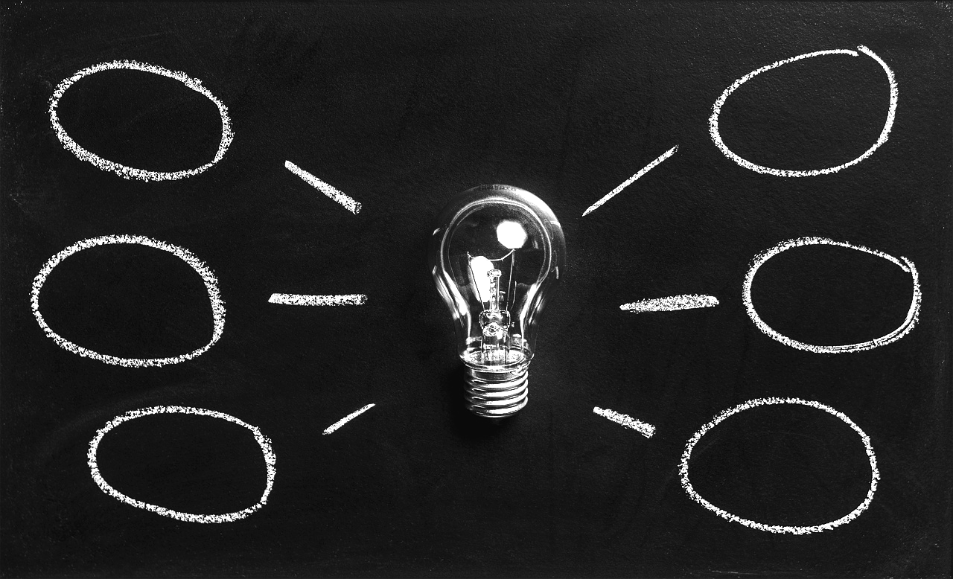
What are you suggestions?
Notes:
John’s slide

